Slide 1
What’s for Diner Finder?
Mai Lam, Anna Kaufmann, Hoon Park

Slide 2
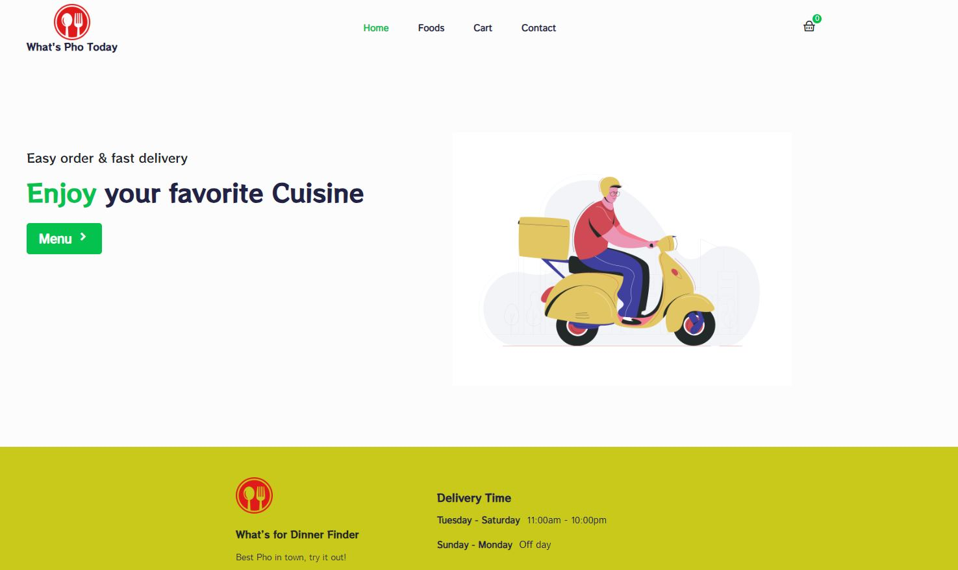
Front Page

Slide 3
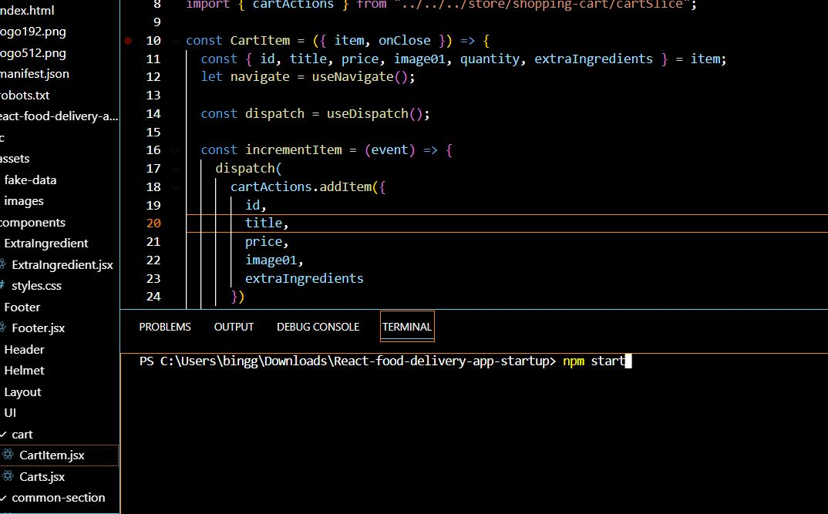
How to start the project

Slide 4
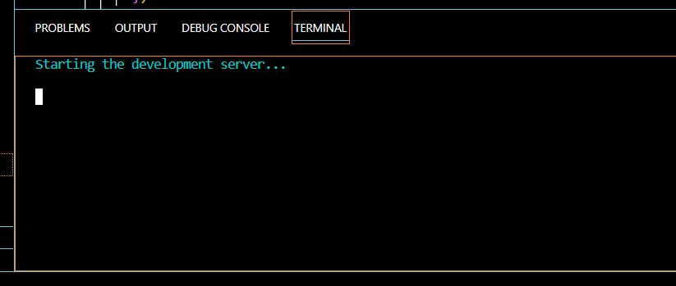
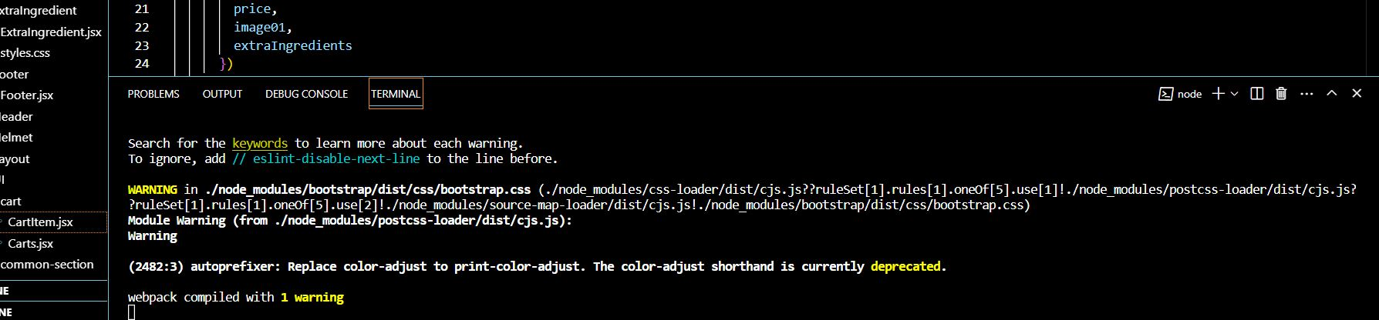
Terminal running

Slide 5
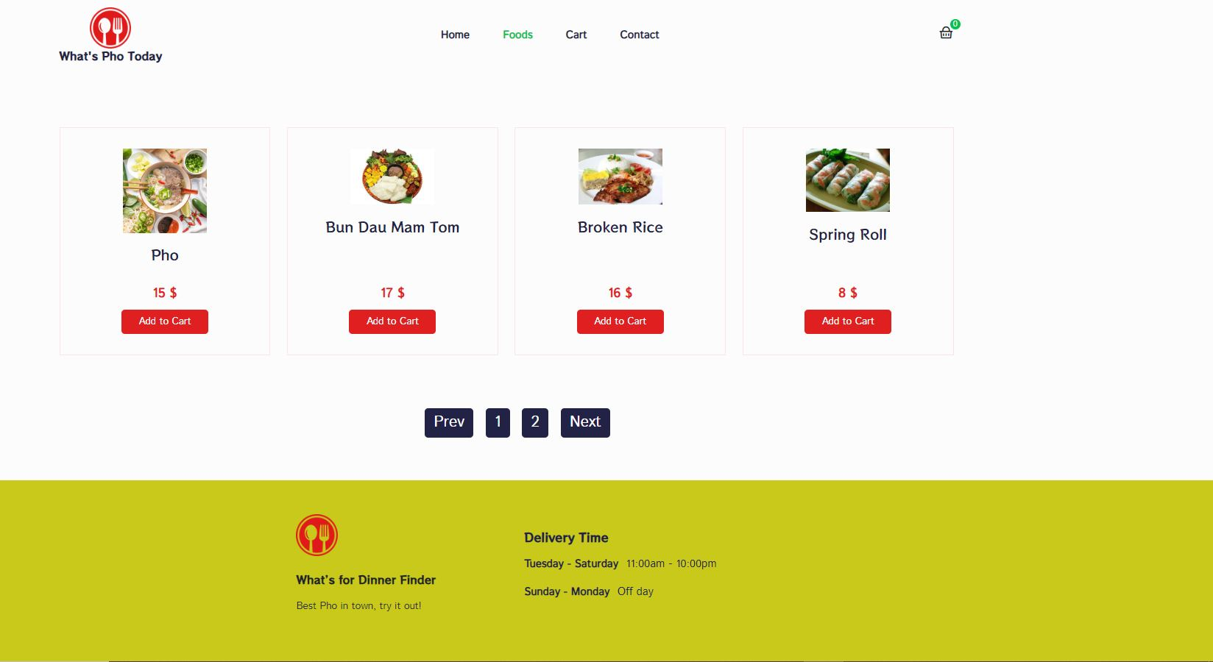
Food Page

Slide 6
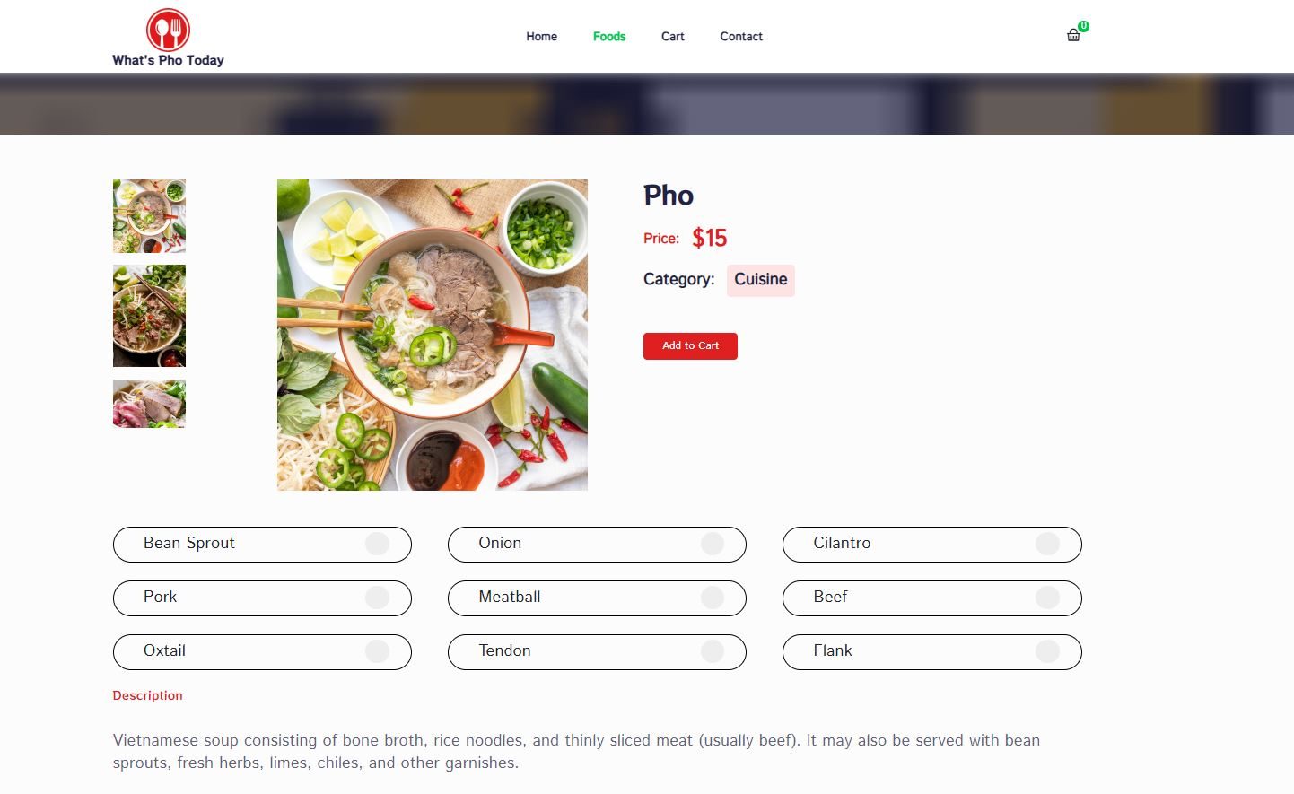
Food Ordering and Options

Slide 7
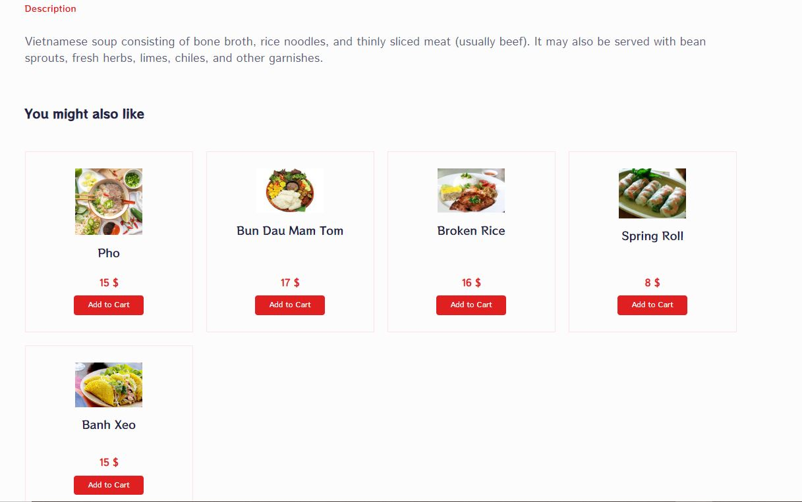

Slide 8
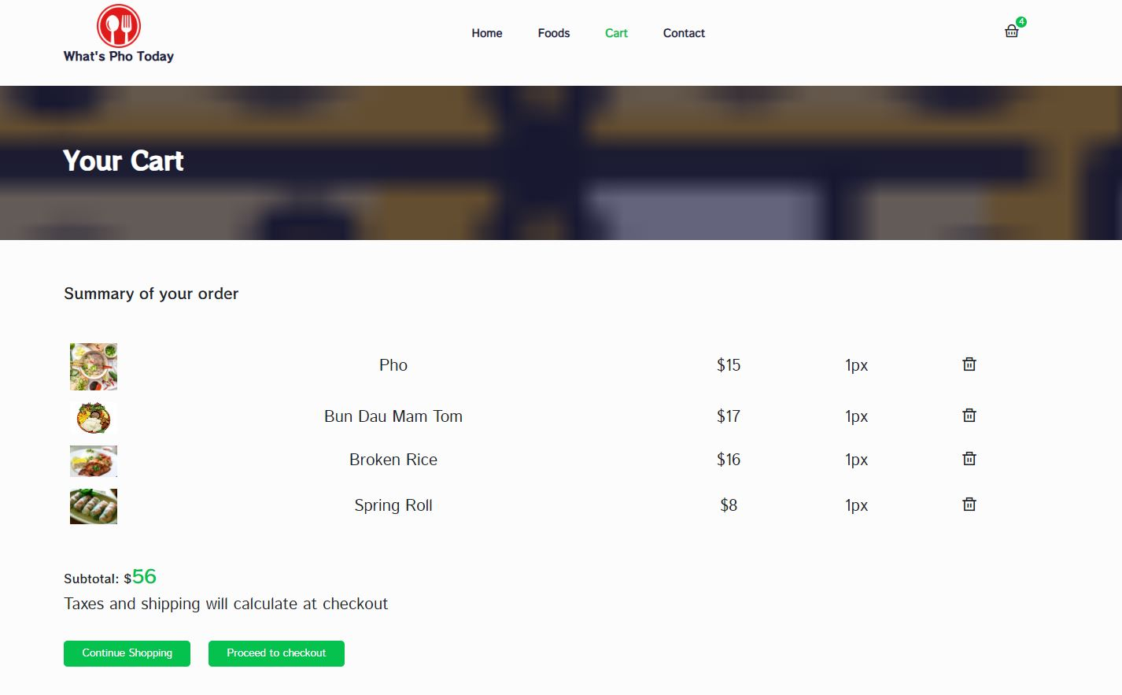
My Cart

Slide 9
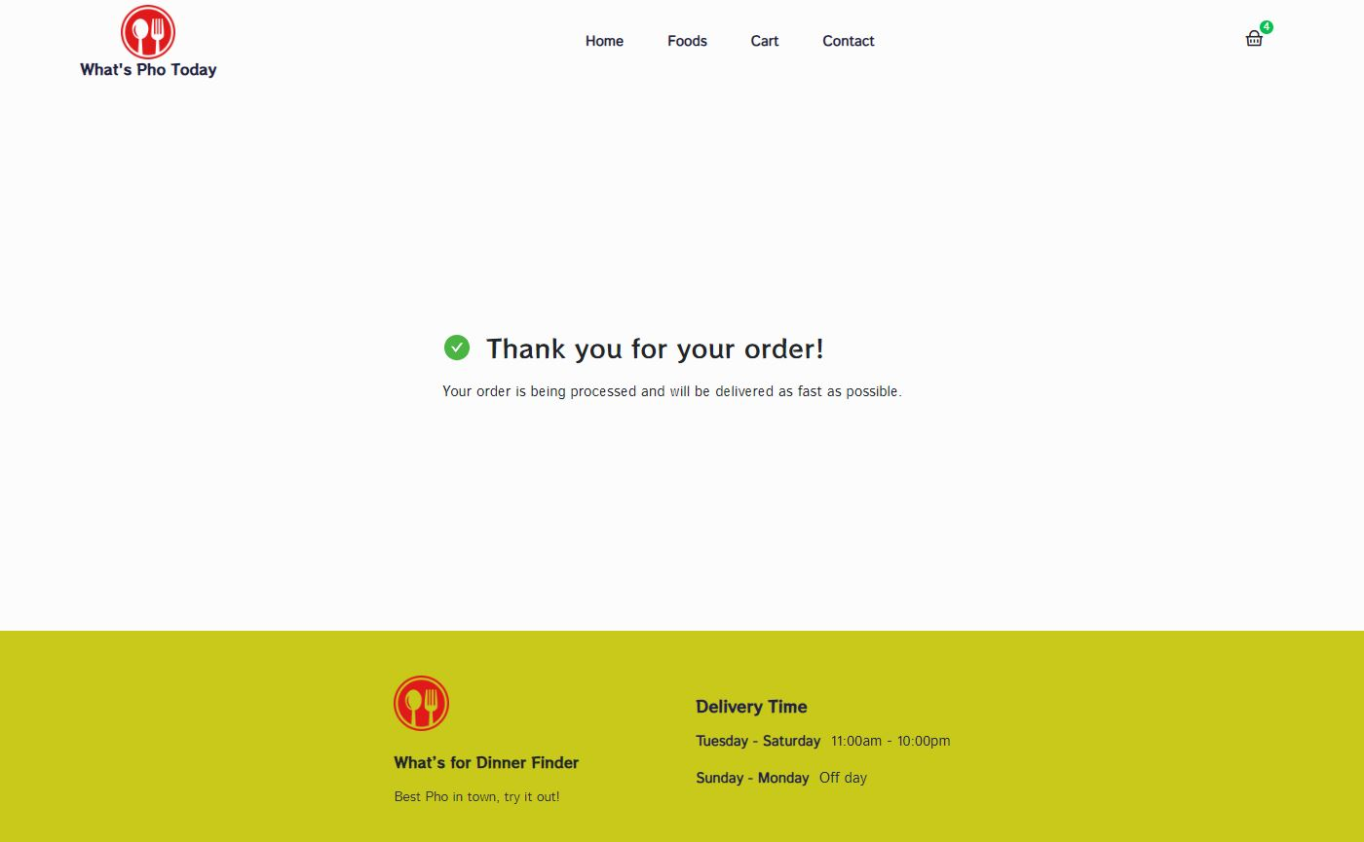

Slide 10
Source
Fork from: https://github.com/codingwithmuhib/React-food-delivery-app
Our adjusting version:
https://github.com/lthmai121/Food-delivery-CS3332-1

